Slide 1
HEAT Framework
High Order Thinking + Engagement + Authenticity + Technology Integration

Slide 2

Session Objectives
Content Objective
Today I will examine the HEAT Framework as a vehicle to increase ELL performance.
Language Objective
Today I will read and share with my peers what I learned about the HEAT Framework.

Slide 3

3 Step interview
“It’s the thought
that counts!”
Notes:
Get up and walk around during the song
When the song stops, find a partner
Introduce yourself
Discuss the phrase as it relates to you in an education setting
Be ready to come back to your tables to discuss what you heard (not what you said!)
Guided discussion: The role of the teacher is to develop good thinkers (long-life learners and problem solvers), not just good recipients of information (It’s the THOUGHT that counts)

Slide 4
Turning Up the HEAT!
H : Higher Order Thinking
E : Engaged Learning
A : Authentic Learning
T : Technology
Notes:
Divide participants in four groups and assign each group a letter: H E A T

Slide 5
Circle Map
Black: What I know
Blue: What I learned
from the text
H
Higher Order
Thinking
Red: What I learned from others
Notes:
1. Teachers write in black everything they know about their own category: H. E. A. or T.
2. Then they will read and discuss their category from the HEAT handout; they will add in blue what else they learned about their category
3. Teachers will post their charts and they will add in red what else they know about each category, through a gallery walk
4. Teams come back and debrief to summarize their findings
5. “Person with longest hair on each team stands up… and selects who will debrief the whole class”

Slide 7

Turning Up the HEAT!
Secondary: The Math Trail
Notes:
Click on the link to watch Ms. Toliver’s secondary video and ask participants to evaluate using the HEAT Framework
How could you turn up the HEAT on her lesson (move to the next level)?

Slide 8
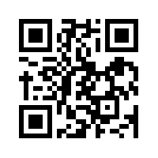
Let’s kahoot!
kahoot.it
create.kahoot.it

Slide 9
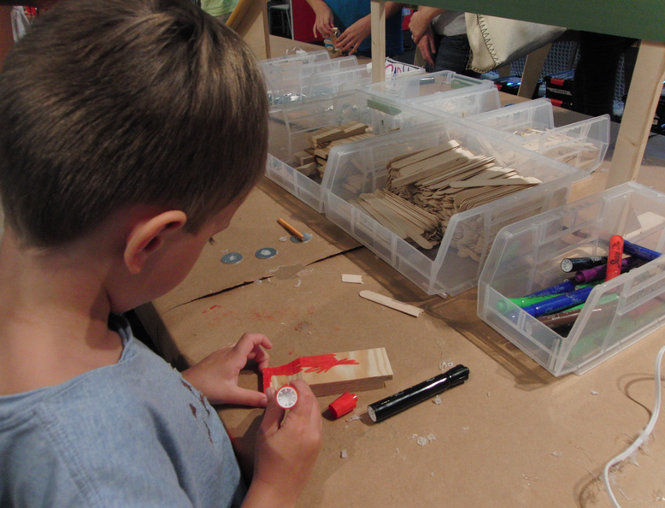
Turning Up the HEAT!
Elementary: The Tinkertoy Derby
Notes:
Click on the link to watch Ms. Toliver’s elementary video and ask participants to evaluate using the HEAT Framework
How could you turn up the HEAT on her lesson (move to the next level)?

Slide 10
Let’s kahoot!
kahoot.it
create.kahoot.it

Slide 11

High Impact Support
for ELL Success

Slide 12
Frameworks
Professional Learning
Onsite Support
Measurement Tools
High Impact Support

Slide 13
Frameworks
Professional Learning
Onsite Support
Measurement Tools
High Impact Support

Slide 14
High Impact Support Frameworks
LoTi
H.E.A.T.

Slide 15
Levels of Teaching Innovation Framework: LoTI
Cognitive Complexity
(High)
LoTi 6
LoTi 5
LoTi 4
Student-directed
LoTi 6
LoTi 5
LoTi 4
Problem-based
LoTi 3
LoTi 2
LoTi 1
Practice-based
LoTi 3
LoTi 2
LoTi 1
Teacher-directed
Cognitive Complexity
(Low)

Slide 16
H.E.A.T. Framework
Higher order thinking
Engaged Learning
Reporting Information
Remembering/Understanding
Applying/Analyzing
Solving teacher-directed problem
Evaluating/ Creating
Solving student directed problem-s
Expansive
Relevant
Limited
Connected
Vague
Authentic Connections
Technology Use
Non-use

Slide 17
Frameworks
Professional Learning
Onsite Support
Measurement Tools
High Impact Support

Slide 22
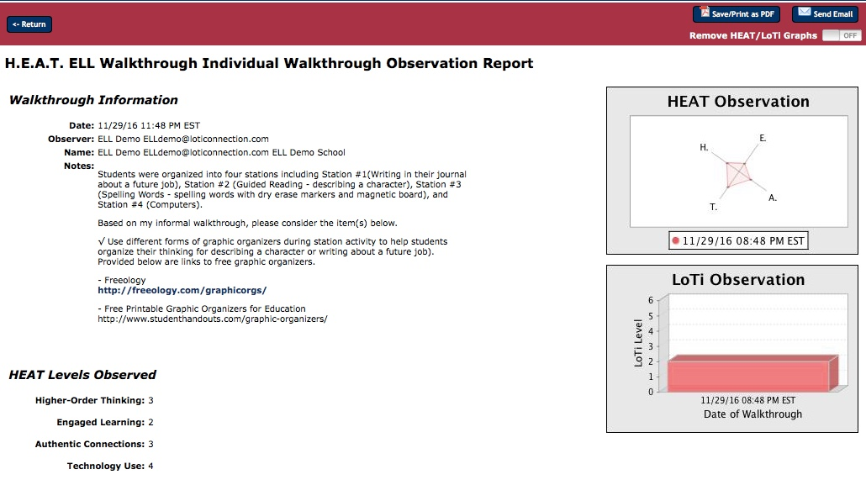
Recommended links for improving practice

Slide 23
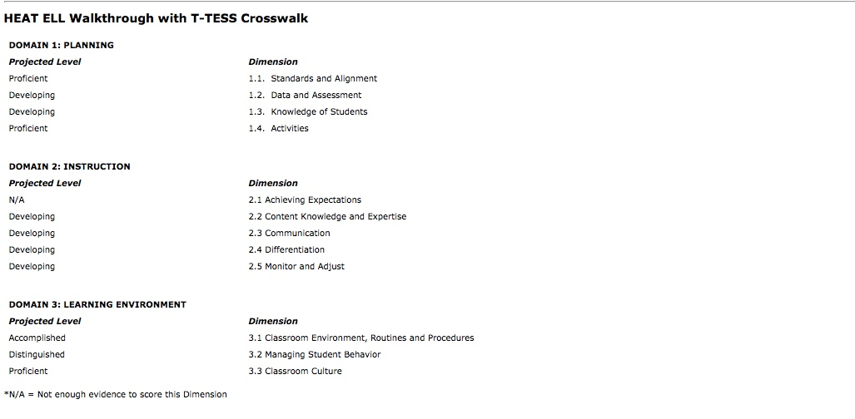
Auto-populates
T-TESS Domains 1, 2, and 3 based on H.E.A.T. input

Slide 24
Frameworks
Professional Learning
Onsite Support
Measurement Tools
High Impact Support

Slide 26
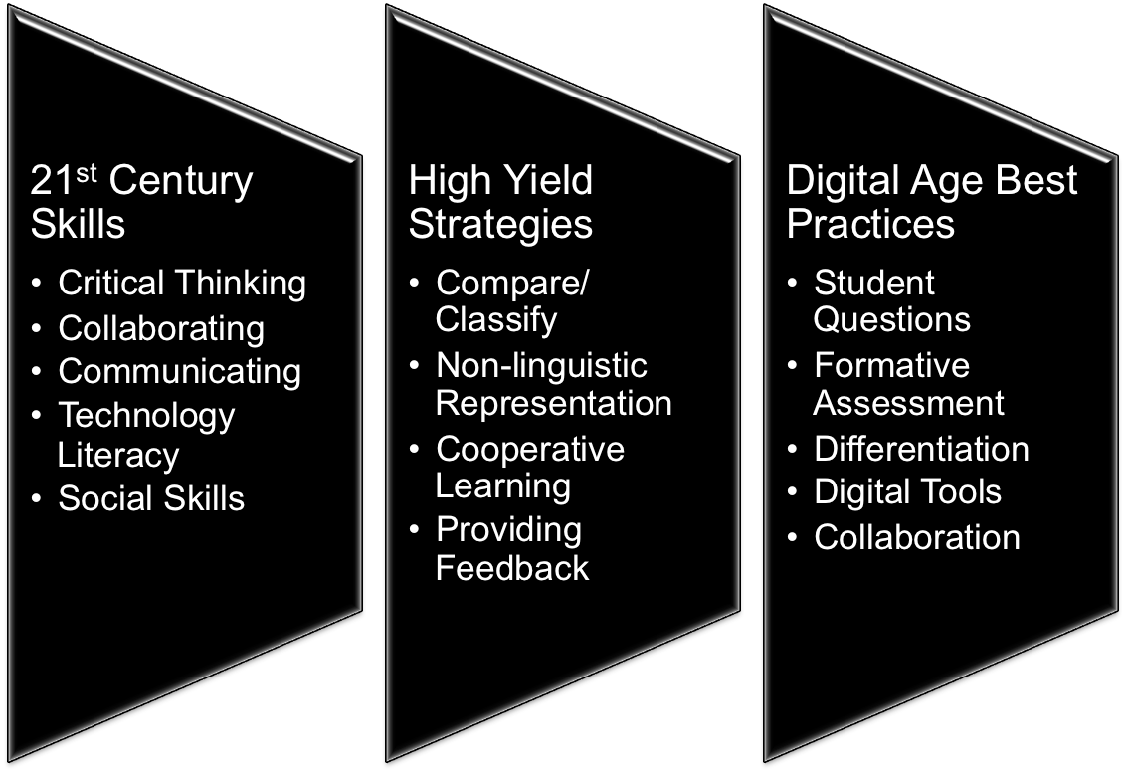
Best Practices
©2017 Region One Education Service Center

Slide 27
ELPS Connections
©2017 Region One Education Service Center

Slide 28
Best Practices
ELPS 1
Content/Language Proficiency Objectives
ELPS 2
Learner interaction, social context, questioning
ELPS 3
Non-linguistic representation
ELPS 4 Collaboration
ELPS 5 Speaking, listening, reading, and writing skills
ELPS 6 Differentiated Learning

Slide 29
Frameworks
Professional Learning
Onsite Support
Measurement Tools
High Impact Support

Slide 30
Measure Opportunities
Integrate Best Practices
Inspire Innovation
Support & Develop

Slide 31
Dr. Chris Moersch
chris@loticonnection.com
Dr. Desiree Marks-Arias
desiree@loticonnection.com

Slide 32

How does the HEAT Framework fit into your plans?

Slide 33
Tickets Out
I used to think…
But now I know…

Slide 34
Thank you for your participation!
Karina E. Chapa, M.Ed.
Language Proficiency, Biliteracy and Cultural Diversity Director
kchapa@esc1.net
Facebook: Region One ESC Bilingual
Twitter @esc1bilingual @bilingualpride

